Slide 1
Auto tuning Industrial Servo Systems – METU lab setup
2244-Arçelik-METU cooperation

Slide 2
Test Bench in METU
Servo motor
DC motor
Elastic coupling
SIEMENS
SIMOTICS S-1FL6 3-SERVO MOTOR
1P 1FL6034-2AF21-1AA1 FS02
S LMH/M321710781073
Mn:1.27Nm Mo:1.27Nm Un:105V
Pn:0.4kW In:2.6A Io:2.58A n:3000r/min
Nmax:5000r/min IP65 S1 1.5kg ID54
Encoder: Inc. 2500ppr
CARTER
REGENT MOTOR
Code:KMUB504BB Volts:230
Cyc.:DC/60 HP:1/4 Amps:2.0
RPM:5000 Duty: Con. OC RISE:50
SER NO:M-1145
Rf:10.5 Ohm Ra:6.3 Ohm
Armature
Field
U V W
Armature feed
DC resistance load
Quadrature
Encoder
Pulse (QEP)
Texas
TMDXIDDK379D

Slide 3
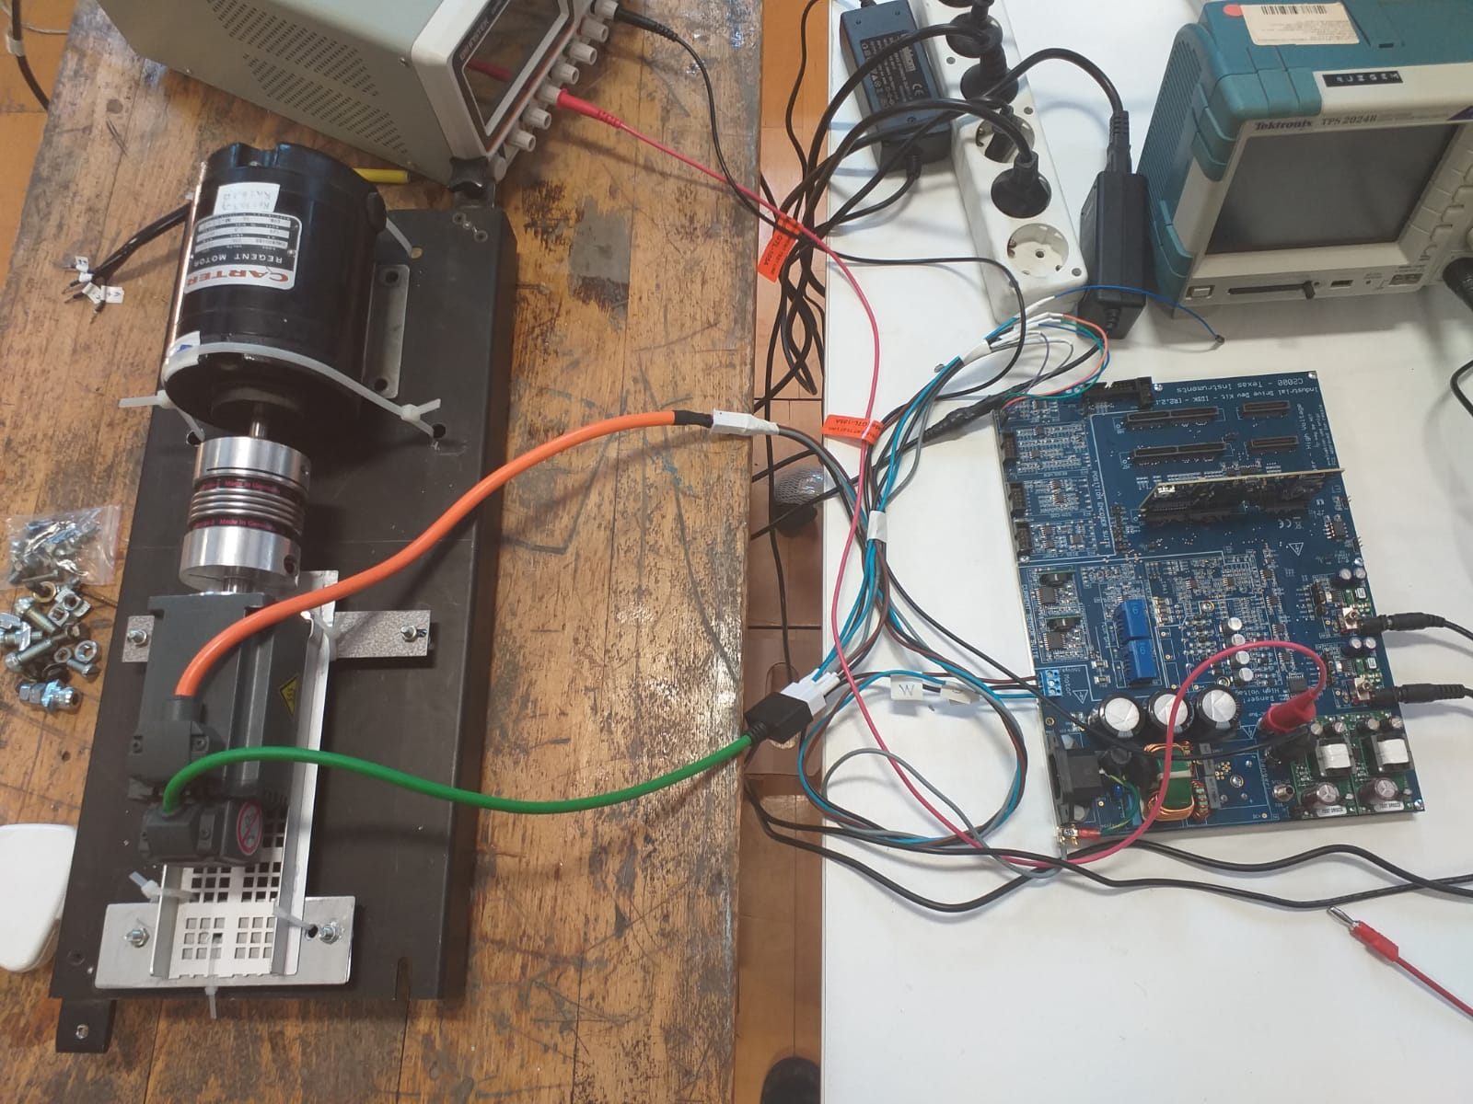
Test Bench in METU

Slide 4
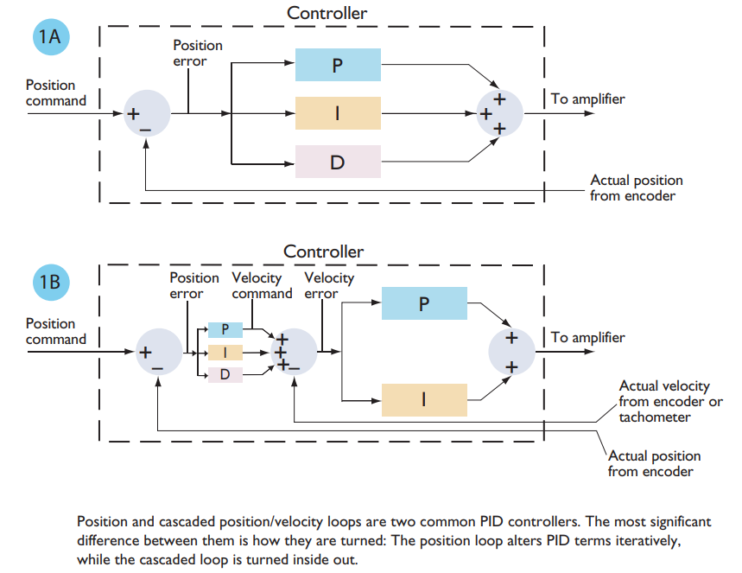
Position -> Cascaded Position+Speed

Slide 5
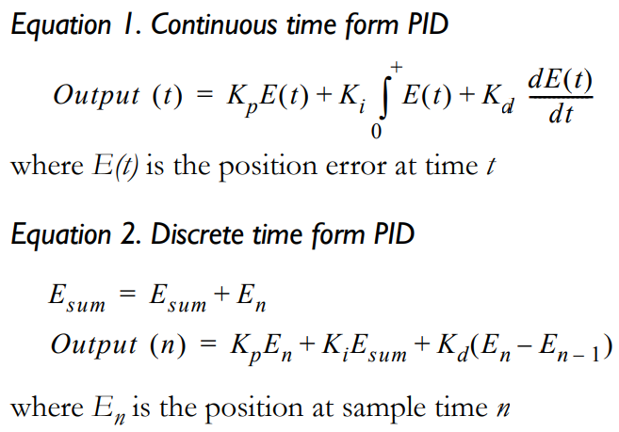
Cont. PID (model) – Disc. PID (setup)
D (derivative) term introduces resistance or drag,
P (proportional) term introduces a linear restoring force,
I (integral) introduces a time-dependent windup term.

Slide 6
PID Tuning Methods
Step Response Method
Zone-Based Tuning (Zone=Frequency)
Additional tunings:
Feeding-Forward (Profile Generator)
Filtering (Biquad)

Slide 7
1. Step Response Method (1)
step-response method, it measures the response of the servo system to an instantaneous (within one servo cycle) change in position.
For step-response tuning we need to display desired position, actual position, and position error (the difference between these two).

Slide 8
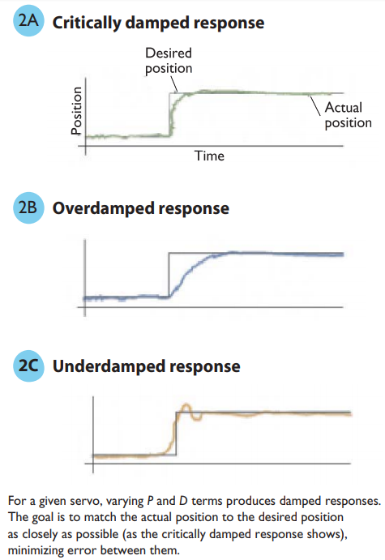
1. Step Response Method (2)
Step-response tuning:
Initialize the I term to zero
Set the D term to a small nonzero value.
Increase P from zero until the system substantially overshoots.
Then increase D until the oscillation is “critically damped.” Figures 2A, 2B, and 2C show approximate traces of underdamped, overdamped, and critically damped step responses.
Continue this process until you find values that have a high P while still being critically damped

Slide 9
1. Step Response Method (3)
Although very easy to use, this method has the problem that increasing D will cause the optimum value of P to change, which in turn changes the optimum value of D, etc.
This requires a number of iterations to get to stable values.
In general terms this is because the D term of a PID operates at the highest frequency zone, the P term at a middle point, and the I term at the lowest frequency zone.
What would be better is if we could first tune the highest frequency component, then move to the middle range value, and finish with the low frequency part.

Slide 10
2. Zone-Based Tuning (1)
“Zone-based” refers to the frequency zones of the P, I, and D terms.
In this method we will plot velocity versus time and the desired profile will be a step function of the velocity (not the position).

Slide 11
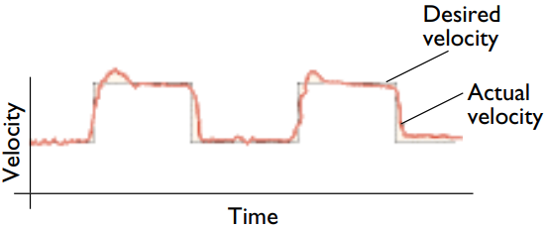
2. Zone-Based Tuning (2)
Zone-based Tuning:
Set the profile so that it accelerates instantaneously between a velocity of zero and a fixed velocity, and back to zero.
Leaving the P and I terms at zero, increase D until the actual velocity profile closely matches the desired velocity profile.
Do not worry about whether the destination positions match, you are only examining differences in velocity (velocity error) at this stage.

Slide 12
2. Zone-Based Tuning (3)
Now set up your profiler so that you are using moves with accelerations and velocities typical for your application, and change the capture facility so that it plots the desired position, actual position, and position error.
Increase P until the servo error is minimized.
At some point as you increase P the motion may have high overshoot, or become unstable, at which point you should back off of this value by at least 20% for the final value.
Zone-based tuning has a number of advantages over step-response tuning. For one, it is less iterative, because it tunes the PID terms in order of the frequency response domain. Secondly, it allows you to utilize real motion profiles with ramps, rather than unrealistic position jumps.

Slide 13
About Ki
Conspicuously absent from this discussion of manual tuning methods is Ki, the integral gain. In general, we want to keep the integral term as small as possible, because it is a direct contributor to servo instability or as it is expressed in servo analysis terms, to a loss of phase margin. Typically, in manual tuning methods, Ki is the last parameters set, and is used to offset DC biases on the load such as gravity, or to bring final position errors to a very small value, or to reduce position errors at higher velocities.

Slide 14
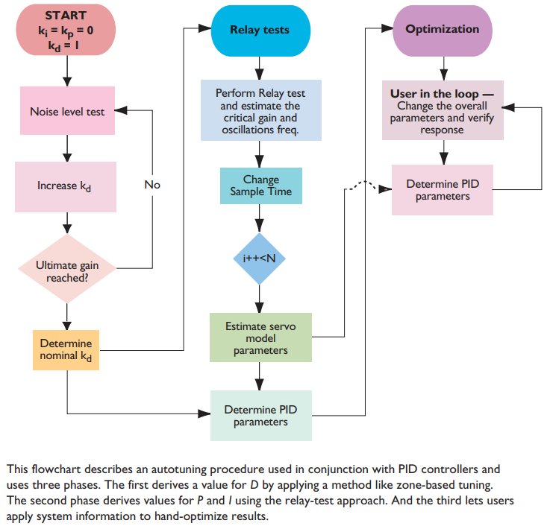
Sample of auto-tune by zone-based tuning
This method uses three phases. The first phase is used to derive a value for D, using a method similar to that used in zone-based tuning. The second phase derives values for P and I using the relay test approach described above. And the third phase uses information acquired about the system to allow the user to hand-optimize the results, but using inputs such as “quieter versus noisier” and “aggressive versus less aggressive” to provide meaningful yet easy-to-understand control inputs.

Slide 15
3. Feeding-Forward (Profile Generator) (1)
It is possible to improve system performance further, even for a welltuned system, by “feeding-forward” offsets directly into the output of the servo loop. In the context of motion control, this technique is generally used with the profile generator to provide velocity feed-forward and acceleration feed-forward controls.

Slide 16
3. Feeding-Forward (Profile Generator) (2)
Velocity feed-forward is useful to compensate for any viscous friction or velocity proportional lagging force. This includes some types of friction forces on the motor or load.
It is also common if a voltage-mode amplifier (one without a torque loop) is used, because in these types of amplifiers back-EMF introduces a velocity-proportional lag.

Slide 17
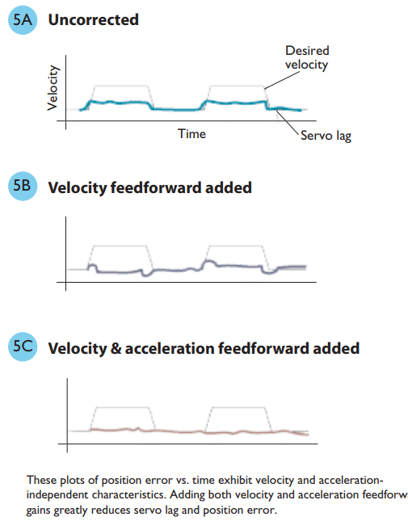
3. Feeding-Forward (Profile Generator) (3)
Acceleration feed-forward is useful to compensate for any acceleration-proportional lagging force. This includes, in theory, all hardware with non-zero inertia, because basic physics dictates that if we change velocity, the object will resist this change, and this resistance will show up as an acceleration proportional lag.

Slide 18
4. Filtering (Biquad) (1)
Many modern servo filters provide some facility for frequencydependant filtering. This is useful for compensating for mechanical systems that have a resonance at a certain frequency or speed, or to reduce high frequency noise.
The most common implementation of such a filter is known as a bi-quad filter, by choosing the right values for A1, A2, B0, B1, and B2 this filter can function as a notch filter, band-pass filter, high or low-pass filter.

Slide 19
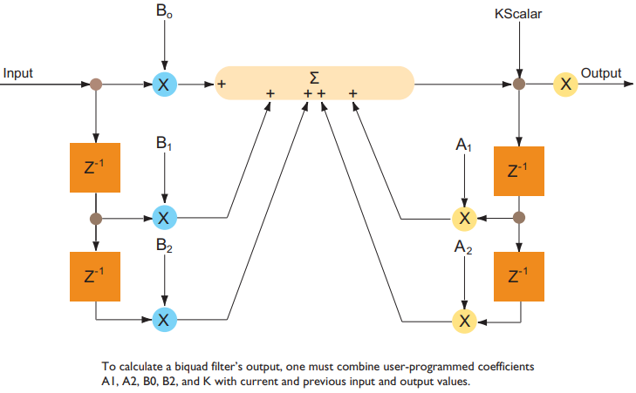
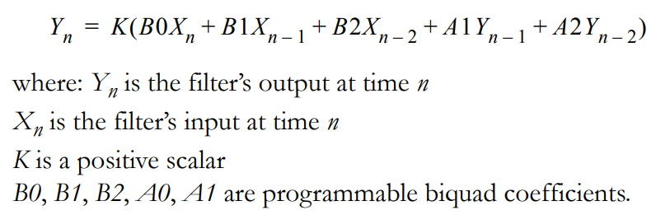
4. Filtering (Biquad) (2)

